Slide 1
Lecture 2
OS Overview
National University of
Computer & Emerging Sciences

Slide 2
The Operating System controls the machine
gcc
gdb
User
OS Kernel
grep
diff
Application
Hard
ware
vi
date
Operating System
xterm
emacs
Hardware
netscape

Slide 3
A better picture
Many
applications
Application
One Operating
System
System
calls
Operating
System
One Hardware
Hardware

Slide 4
Operating System in Action
OS is a program, just like any other program
When you turn power on, bootstrap program is loaded from ROM
Boot program
  Examine/check machine configuration
    # CPUs
    How much memory
    # and type of HW devices
  Build configuration structure describing the HW
  Locates and Loads the OS
  The control transfers to the OS
Notes:
POST, display info, access and check boot loader and load in RAM

Slide 5
Operating System in Action
Operating System:
Initialize kernel data structures
Initialize state of HW devices
Creates a number of processes to start operation

Slide 6
Components of an OS

Slide 7
Common System Components
Process Management
Main Memory Management
File Management
I/O System Management
Secondary Management
Networking
Protection System
Command-Interpreter System

Slide 8
Process Management
Creation/deletion of a process
Create and make available, an execution environment
Suspension/resumption and CPU scheduling in a fair manner
Mechanisms for synchronization
Mechanisms for inter-process communication
Deadlock handling

Slide 9
Operating System Services

Slide 10

A View of Operating System Services

Slide 11
Operating System Services
Program execution – system capability to load a program into memory and to run it
I/O operations – since user programs cannot execute I/O operations directly, the operating system must provide some means to perform I/O
File-system manipulation – program capability to read, write, create, and delete files
Communications – exchange of information between processes executing either on the same computer or on different systems tied together by a network. Implemented via shared memory or message passing
Error detection – ensure correct computing by detecting errors in the CPU and memory hardware, in I/O devices, or in user programs

Slide 12
A View of Operating System Services

Slide 13
System Calls
Programming interface to the services provided by the OS
Typically written in a high-level language (C or C++)
Mostly accessed by programs via a high-level Application Program Interface (API) rather than direct system call use
Three most common APIs are Win32 API for Windows, POSIX API for POSIX-based systems (including virtually all versions of UNIX, Linux, and Mac OS X), and Java API for the Java virtual machine (JVM)

Slide 14

Example of System Calls
System call sequence to copy the contents of one file to another file

Slide 15

API – System Call – OS Relationship

Slide 16
Operating-System Operations
Interrupt driven (hardware and software)
  Hardware interrupt by one of the devices
  Software interrupt (exception or trap):
    Software error (e.g., division by zero)
    Request for operating system service
    Other process problems include infinite loop, processes modifying each other or the operating system

Slide 17
Operating-System Operations (cont.)
Dual-mode operation allows OS to protect itself and other system components
  User mode and kernel mode
  Mode bit provided by hardware
    Provides ability to distinguish when system is running user code or kernel code
    Some instructions designated as privileged, only executable in kernel mode
    System call changes mode to kernel, return from call resets it to user
Increasingly CPUs support multi-mode operations
  i.e. virtual machine manager (VMM) mode for guest VMs

Slide 18

Transition from User to Kernel Mode
Timer to prevent infinite loop / process hogging resources
  Timer is set to interrupt the computer after some time period
  Keep a counter that is decremented by the physical clock.
  Operating system set the counter (privileged instruction)
  When counter zero generate an interrupt
  Set up before scheduling process to regain control or terminate program that exceeds allotted time

Slide 19
Dual-mode operation
Dual-mode operation allows OS to protect itself and other system components
  User mode and kernel mode
  Mode bit provided by hardware
    Provides ability to distinguish when system is running user code or kernel code
    Some instructions designated as privileged, only executable in kernel mode
    System call changes mode to kernel, return from call resets it to user
Notes:
Dual mode is an important aspect, that is used to protect OS and other components from unprivileged intervention.

Slide 20
Transition from User to Kernel Mode

Slide 21

Standard C Library Example
C program invoking printf() library call, which calls write() system call

Slide 22
System Call Parameter Passing
methods used to pass parameters to the OS
  Simplest: pass the parameters in registers
    In some cases, may be more parameters than registers
  Parameters stored in a block, or table, in memory, and address of block passed as a parameter in a register
    This approach taken by Linux and Solaris
  Parameters placed, or pushed, onto the stack by the program and popped off the stack by the operating system
  Block and stack methods do not limit the number or length of parameters being passed

Slide 23
Types of System Calls
Process control
File management
Device management
Information maintenance
Communications
Protection

Slide 24

Examples of Windows and Unix System Calls

Slide 25
Operating System Design and Implementation

Slide 26
Simple Structure
MS-DOS – written to provide the most functionality in the least space
  Not divided into modules
  Although MS-DOS has some structure, its interfaces and levels of functionality are not well separated

Slide 27

MS-DOS Layer Structure

Slide 28

Layered Operating System

Slide 29
Layered Approach
The operating system is divided into a number of layers (levels), each built on top of lower layers. The bottom layer (layer 0), is the hardware; the highest (layer N) is the user interface.
With modularity, layers are selected such that each uses functions (operations) and services of only lower-level layers

Slide 30

Solaris Modular Approach

Slide 31
Monolithic vs. Microckernel Design
MS-DOS, UNIX, and most other OSes implement what is called a monolithic design
  Kernel is relatively large, contains much code
  File systems, device drivers, etc. are all run with full kernel privileges
  Hybrid/Layered systems are still largely monolithic designs!
MINIX and Mach are examples of a Microkernel design
  Kernel is small, delegates much of core system functionality to user-space daemons
  Typically only the most core functionality is implemented in kernel space
    Process and memory management, message passing
  Benefits include that it is easier to extend/port a microkernel, more reliable/secure (less code is running in kernel mode)
  Detriments include performance overhead of user space to kernel space communication

Slide 32
Microkernel System Structure
Moves as much from the kernel into user space
Mach example of microkernel
  Mac OS X kernel (XNU) partly based on Mach with components from BSD as well – not a true microkernel system
MINIX is a microkernel based OS designed originally by Andrew Tanenbaum for educational purposes
  Now aims to create a highly-reliable self-healing OS, which is one of the benefits of a microkernel architecuture
Communication takes place between user modules using message passing

Slide 33

Microkernel System Structure

Slide 34
Virtual Machines

Slide 35
Question
Can a “small” operating system simulate the hardware of some machine so that
  Another operating system can run in that simulated hardware?
  More than one instance of that operating system run on the same hardware at the same time?
  More than one different operating system can share the same hardware at the same time?
Answer: Yes

Slide 36
Solution – Virtual Machine
A virtual machine provides interface identical to underlying bare hardware
  I.e., all devices, interrupts, memory, page tables, etc.
Virtual Machine Operating System creates illusion of multiple processors
  Each capable of executing independently
  No sharing, except via network protocols

Slide 37

Virtual Machines (Cont)
(a) Nonvirtual machine (b) virtual machine
Non-virtual Machine
Virtual Machine

Slide 38
Java Virtual Machine
Compiled Java programs are platform-neutral byte-codes executed by a Java Virtual Machine (JVM)
JVM consists of
  Class loader
  Class verifier
  Runtime interpreter
Just-In-Time (JIT) compilers increase performance

Slide 39
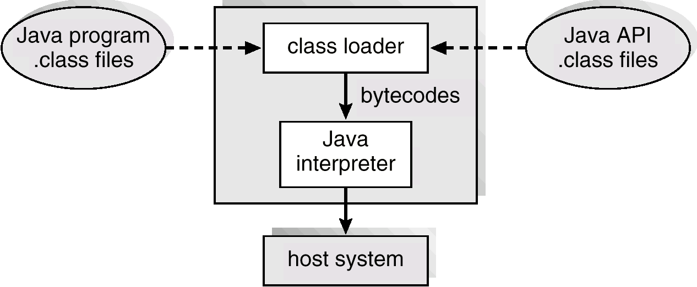
The Java Virtual Machine

Slide 40
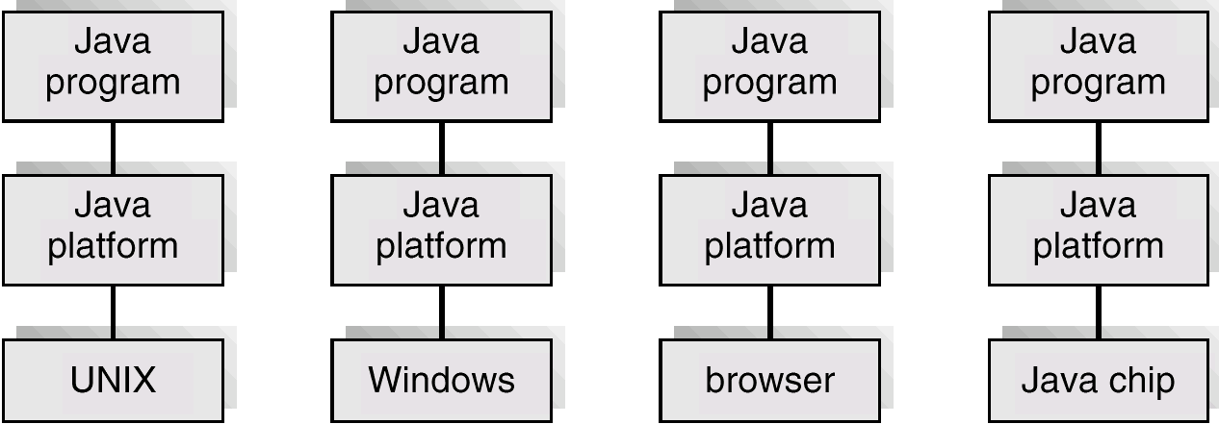
The Java Platform

Slide 41
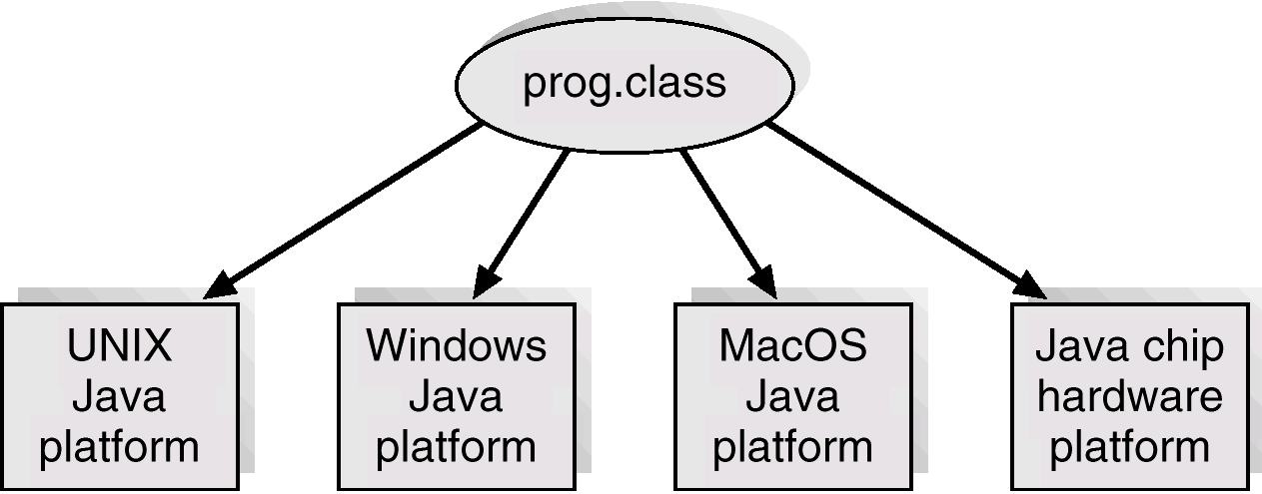
Java .class File on Cross Platforms

Slide 42
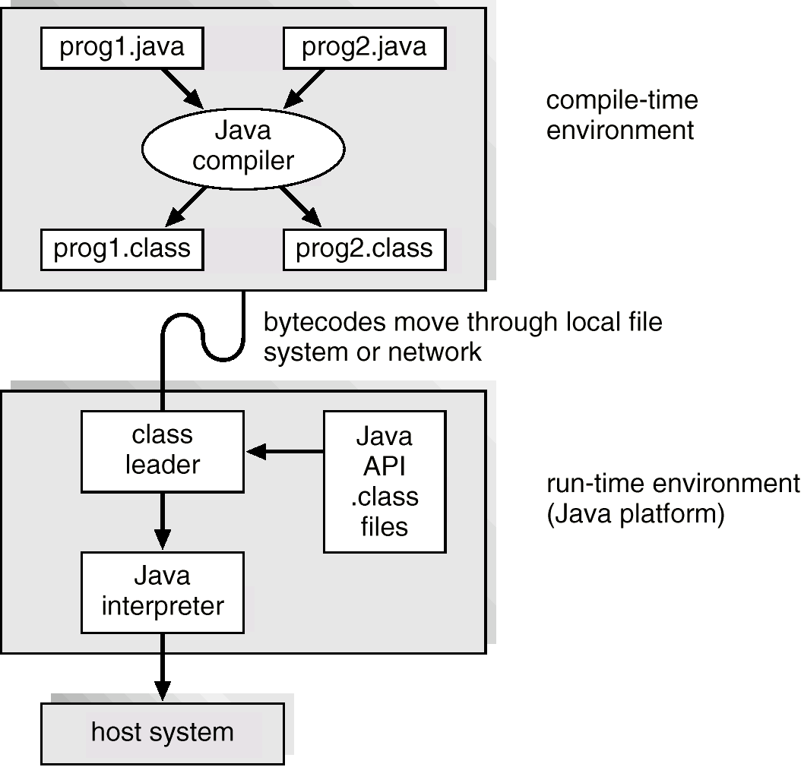
Java Development Environment

